Slide 1


Globalisation
in
India
(Economics Presentation)

Slide 2

Introduction to Globalisation
Globalisation refers to the interconnectedness and interdependence of nations on a global scale. This interconnectedness is driven by factors like trade, technology, and cultural exchange.
In the context of India, globalisation has been marked by its gradual integration into the global economy, leading to significant economic growth and social transformation.

Slide 3

Process of Globalisation
Trade liberalization: Reducing trade barriers and promoting free trade.
1
Capital flows: Increased investment and financial integration across borders.
2
Technology diffusion: Rapid spread of new technologies, like the internet, and communication networks.
3
Cultural exchange: Growing interconnectedness of cultures through media, tourism, and migration.
4

Slide 4
NEP 1991
1
Liberalization
Reduced government control over industries and trade.
2
Privatization
Encouraging private sector participation in various sectors.
Globalization
3
Opening up the Indian economy to foreign investment and trade.

Slide 5

Economic Consequences

Slide 6
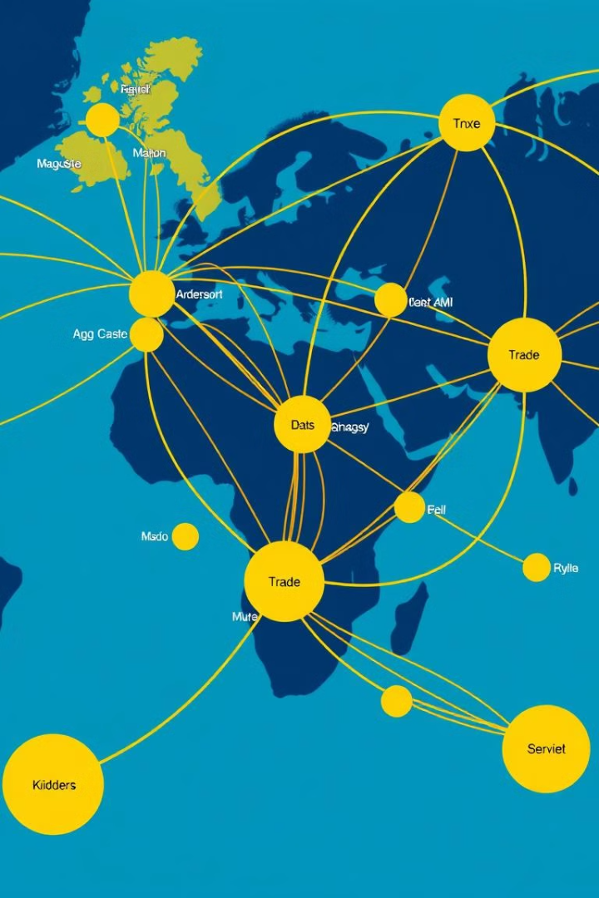



Economic Globalisation: Driving Forces of Growth
Trade Liberalization
Foreign Direct Investment
The reduction of trade barriers, such as tariffs and quotas, has facilitated free trade, allowing goods and services to flow more freely between countries. This has boosted global trade, leading to increased economic activity and growth.
Increased foreign direct investment, particularly in emerging markets like India, has fueled economic growth, creating jobs, and driving technological advancement. This flow of capital has been crucial in developing infrastructure and industries.
Technological Advancement
The rapid advancement in technology, particularly in communication and transportation, has facilitated seamless global connectivity, bridging geographic distances and enabling faster trade and collaboration.

Slide 7
Social and Cultural Globalisation: Intertwined Worlds
Cultural Exchange
Impact on Traditions
Emerging Global Culture
Globalisation has facilitated cultural exchange, enabling individuals from different countries to interact, share ideas, and learn about each other's cultures. This exposure to diverse perspectives has enriched global understanding and broadened horizons.
While fostering cultural exchange, globalisation has also led to the adoption of global trends, which can sometimes influence or even challenge traditional values and practices. This has sparked discussions about the preservation of cultural identity in an increasingly interconnected world.
Globalisation has contributed to the emergence of a global culture, evident in shared trends in fashion, music, and entertainment. This convergence of cultural elements has created a sense of interconnectedness and a shared global experience.

Slide 8
Government and Regulatory Reforms: Shaping Globalisation
Trade Agreements
1
Governments play a crucial role in facilitating globalisation through trade agreements, such as the World Trade Organization (WTO), which establish rules and guidelines for international trade, reducing barriers and promoting free trade.
Regulatory Harmonization
2
Harmonizing regulations across different countries is essential for facilitating cross-border trade and investment. Efforts to create uniform standards in areas like product safety and environmental regulations can streamline global business operations.
Economic Policies
3
Governments adopt economic policies, such as tax incentives and subsidies, to attract foreign investment and encourage the growth of domestic industries, creating a favorable environment for global business activities.

Slide 9




Challenges
Income Inequality
Globalisation has led to increased income inequality, as some sectors and individuals have benefited more than others. This has created social and economic disparities, requiring measures to address the gap.
Environmental Concerns
Globalisation has accelerated industrialization and urbanization, raising concerns about environmental degradation and climate change. Sustainable development strategies are crucial to mitigate these impacts.
Trade Imbalances
Trade imbalances can arise from globalisation, with some countries having a surplus while others face deficits. Balancing trade and promoting fair competition is crucial for global economic stability.

Slide 10

International Trade: The Backbone of Globalisation
1
Increased Volume and Value
Globalisation has led to a significant increase in the volume and value of international trade. This growth has been fueled by the demand for goods and services across national borders, facilitated by improved transportation and communication infrastructure.
2
Global Supply Chains
Globalisation has fostered the development of complex global supply chains, where production processes are distributed across different countries, enabling businesses to leverage specialized skills and resources from diverse locations.
3
Impact on Industries
International trade has profoundly impacted various industries, leading to increased competition, specialization, and innovation. Businesses now operate in a global marketplace, seeking opportunities to expand their reach and market share.

Slide 11



WTO
The World Trade Organization (WTO) is the only global international organization dealing with the rules of trade between nations. At its heart are the WTO agreements, negotiated and signed by the bulk of the world’s trading nations and ratified in their parliaments. The goal is to ensure that trade flows as smoothly, predictably and freely as possible.
164
13
Members
Rounds
India is a member of the WTO, committed to upholding international trade rules.
India has actively participated in WTO negotiations, shaping trade agreements.

Slide 12




Free Trade Agreements (FTAs): Fostering Regional Cooperation
Reduced Trade Barriers
FTAs aim to reduce or eliminate trade barriers between participating countries, creating a free trade zone where goods and services can flow freely without tariffs, quotas, or other restrictions.
Enhanced Market Access
FTAs provide increased market access for businesses within the participating countries, enabling them to tap into new markets, expand their customer base, and boost their exports.
Economic Integration
FTAs encourage economic integration by fostering collaboration, investment, and trade between participating countries, leading to increased economic activity and growth in the region.

Slide 13

Contemporary Relevance and Benefits of Globalisation
1
2
3
Economic Growth
Job Creation
Consumer Choice
Globalisation has played a crucial role in driving economic growth and prosperity in many countries. It has enabled access to global markets, facilitated foreign investment, and fostered technological innovation.
Globalisation has created new job opportunities in various sectors, particularly in manufacturing, services, and technology. This has boosted employment levels and contributed to economic development.
Globalisation has expanded consumer choice, providing access to a wider range of goods and services from around the world at more competitive prices. This has enhanced consumer satisfaction and benefited the global economy.

Slide 14

Globalisation: Case Studies and Insights
Join us as we delve into the fascinating world of globalisation, examining case studies from India and exploring its multifaceted impact on economies, societies, and cultures.

Slide 15
Tata Starbucks: A Case Study in Globalisation
Local Adaptation, Global Appeal
A Partnership of Strength
Tata Starbucks exemplifies the power of strategic alliances. Tata Group's deep understanding of the Indian market, coupled with Starbucks' global expertise, created a successful partnership. The venture thrived by adapting to local tastes and preferences, offering unique blends and beverages to resonate with Indian consumers.
The success of Tata Starbucks lies in its ability to blend global appeal with local adaptation. The menu incorporates Indian flavors while staying true to Starbucks' brand identity. This approach has been instrumental in attracting a diverse customer base and establishing a strong presence in the Indian market.

Slide 16



Maruti Suzuki: A Success Story of Globalisation
Global Technology & Local Expertise
Maruti Suzuki's success lies in its strategic partnership with Suzuki, leveraging global automotive technology and local manufacturing expertise. They adapted models to suit Indian roads and driving conditions, resulting in a wide range of affordable and reliable cars for the Indian market.
1
Strong Local Presence
2
Maruti Suzuki has established a strong local presence, creating a vast network of dealerships and service centers across India. This commitment to customer service and accessibility has contributed to their dominance in the Indian automobile market.
Market Leadership
Maruti Suzuki has consistently held a dominant position in the Indian automobile market, attributed to their focus on customer needs, value for money, and efficient production processes. This success story demonstrates the power of strategic global partnerships and local adaptation.
3

Slide 17

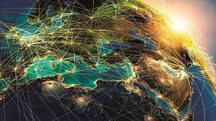
Conclusion
Globalisation has brought both opportunities and challenges to India. The country has successfully leveraged globalisation to fuel economic growth, technological advancements, and social progress. By addressing the challenges, India can navigate the complexities of globalisation and continue its journey towards sustainable and inclusive development.

Slide 18
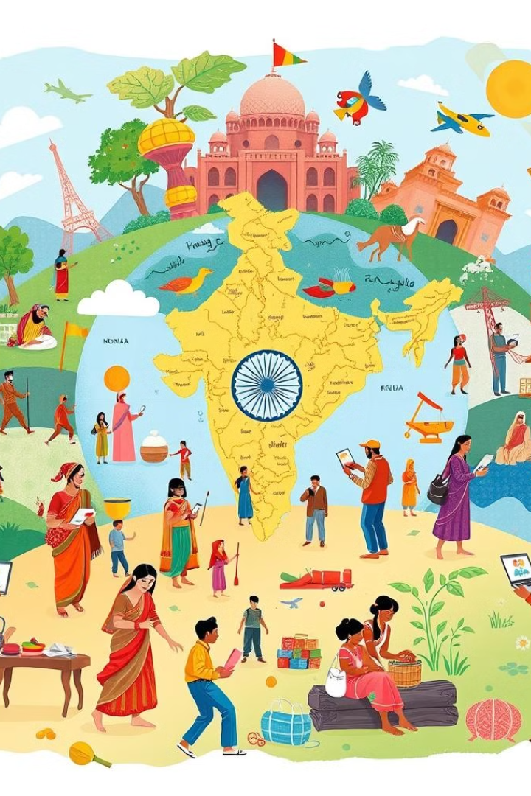
Thank You!!

